Slide 1
PBR VISVODAYA INSTITUTE OF TECHNOLOGY AND SCIENCE DEPARTMENT OF ELECTRICAL AND ELECTRONICS ENGINEERING
(20A05705c)
INDUSTRIAL IOT
EEE - IV. B. Tech SEM – I by A. Bhaktha Vatsala, M.Tech, (Ph.D).
Associate Professor & Head

Slide 2
UNIT-III
KEY AND ON-SITE TECHNOLOGIES

Slide 3
UNIT-III SYLLABUS
KEY AND ON-SITE TECHNOLOGIES
Key Technologies: Off-site Technologies - Introduction, Cloud Computing- Necessity, Cloud Computing and IIoT, Industrial Cloud Platform Providers, SLA, Requirements of Industry 4.0, Fog Computing.
On-site Technologies- Introduction, Augmented Reality- History, Categorization, Applications, Virtual Reality- History, Categorization, Applications.

Slide 4
Introduction:
The communication technologies are among the key IoT-enabling technologies. Communication technologies such as non-cellular (ZigBee, Wi-Fi, LoRaWAN, Radio frequency identification) and cellular networks (2G, 3G, 4G, 5G, LTE, NB-IoT) can be the key for such sensor networks to connect and transmit data.
There are two key technologies in IIOT
1. Off-site Technologies
Examples: Cloud computing, Fog computing
2. On-site Technologies
Examples: Augmented Reality, Virtual Reality

Slide 5
Off-site Technologies:
Introduction:
Off-site technologies, also known as remote technologies or cloud technologies, refer to a range of digital solutions and services that are hosted and operated outside of the user's physical location.
These technologies leverage the internet and remote servers to deliver various computing resources, software applications, storage, and other IT services to users or organizations.
The fundamental idea behind off-site technologies is to provide access to computing resources and services from virtually anywhere, as long as there is an internet connection.

Slide 6
The industrial internet of things(IIoT) supports the industry 4.0 in the aspects of
Sensing,
Communication,
Networking, and
Computing.
Achieves digitalization in manufacturing and production process.
Similarly, IIoT and Big Data required for
Digitalization process
Data acquisition
Asset management
Resource management
Knowledge management
Bulk amount of data due to the time series data streams from end devices

Slide 7
Cloud :
Cloud computing is the delivery of computing services - including servers, storage, databases, networking, software, analytics, and intelligence - over the Internet (“the cloud”) to offer faster innovation, flexible resources, and economies of scale.
Cloud Necessity
1. The major concern of the cloud necessitate to handle huge amount
of amount
2. Nature of data
Unorganized
M2M Sensor data
From heterogeneous big number of device
Varying data quality

Slide 8
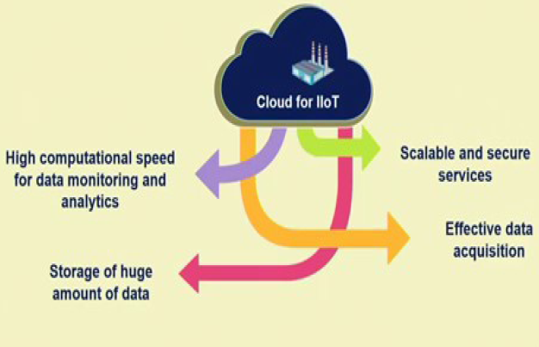
So, to access and store the data properly the cloud is needed for
first thing is that cloud basically gives you a platform for high
computational speed, for data monitoring and analytics
Second benefit is storage of large volumes of data is possible with
cloud in a very simplest manner.
Third is scalability and security of services

Slide 9
Cloud Computing:
Therefore, the people believe that cloud based platforms will give you, a reliable platform, a scalable platform and a secure platform for storage and handling of data and also the acquisition of the data with cloud can be made much more efficient, because of these following:
Suitable for its scientific and business adaptability
Fulfills the need of what, when and where solutions
Secure storage and access
Supports a coherent, expandable and coordinated business model
Supports mobile devices

Slide 10
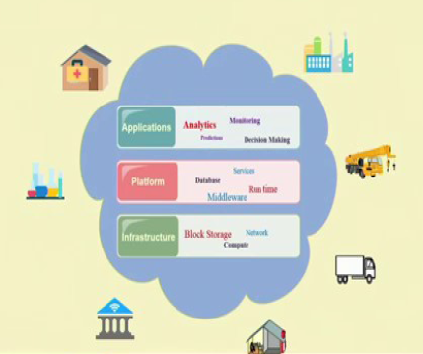
Cloud Computing Architecture:
There are different models, but they started with three different models.
So, whether it is home, hospitals factories the different computational resources available in the form of cloud infrastructure.
Those are computing infrastructure in the form of computational resources CPU, storage, network and so on.
Platform resource which is basically in the form of the development, platform, the middleware services, database runtime and so on the platform resources.
The application resources or the software where we are talking about different software performing, monitoring, decision making, analytics, predictions.

Slide 11
Cloud Computing in IIoT: Services
Three types of services are offering following services in IIoT:
1. Software-as-a-Service (SaaS)
2. Platform-as-a-Service (PaaS) and
3. Infrastructure-as-a-Service (IaaS)
Software-as-a-Service (SaaS)
Industrial applications with web or program Interface
Subscribe-and-use feature to industry clients with final product
Everything managed by the service provider
Ex: Industrial Machinery Catalyst from Siemens is a SaaS for
industrial use

Slide 12
Platform-as-a-Service (PaaS)
Allows industries for self-development of applications
Clients have control over the application and the configuration
environment
EX: Predix (GE), Sentience (Honeywell), and MindSphere
(Siemens) are some industrial PaaS providers
Software firms like Cumulocity, Bosch IoT, and Carriots offer PaaS
for IoT industries.

Slide 13
Infrastructure-as-a-Service (IaaS)
Access to the servers, network and storage and provisioning
Clients can use cloud to operate a virtual data center
Used to deploy PaaS and SaaS
Ex: Microsoft Azure, Google Compute Engine, IBM Smart Cloud
Enterprise, Rackspace Open Cloud, Amazon Web Services
(AWS), etc.

Slide 14
Cloud Computing in IIoT: Deployment Models
Public:
Cloud set-up for use of any person or industry
Virtualized resources are publicly shared
Examples: Google Compute Engine, Amazon Web Service
(AWS), Microsoft Azure, etc.
Private:
Cloud set-up for a single organization
Virtualized resources are shared with the client only
managed by the client itself or a third party
Highly Secure
Hybrid
Cloud set-up by two or more unique cloud set-up (private or public)
Designed to have advantages of both private and public
Flexibility for data and applications movement between private and
public clouds

Slide 15
Cloud Computing in IIoT: End-users
End-users are the industries who actually avail the cloud services
Services differ form firm to firm based on their products and services
Domain of use for IIoT lies in many areas like Healthcare,
Transportation, Manufacturing plants, Refineries, Mining, Marine
and many more.

Slide 16
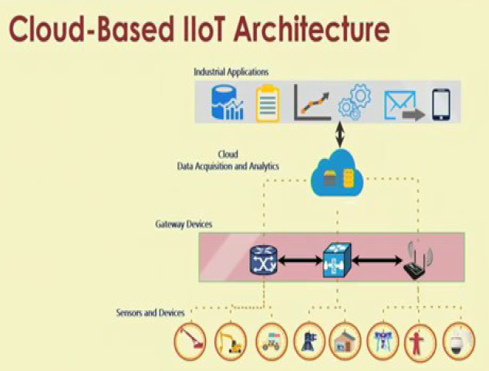

Slide 17
Cloud Computing in IIoT
Industrial big data storage
Heavy weight algorithms for data analytics
Prediction of failures before occurrences
Device provisioning and configuration remotely
Real-time device monitoring
Data privacy and security

Slide 18
Consumer vs. Industrial IoT Cloud Platforms
Consumer IoT cloud platform
Very specific applications for end users
Modest security
Cost sensitive
Industrial IoT cloud Platform
Large number of data points
QoS
Robust security
Return on investment (ROI) sensitive

Slide 19
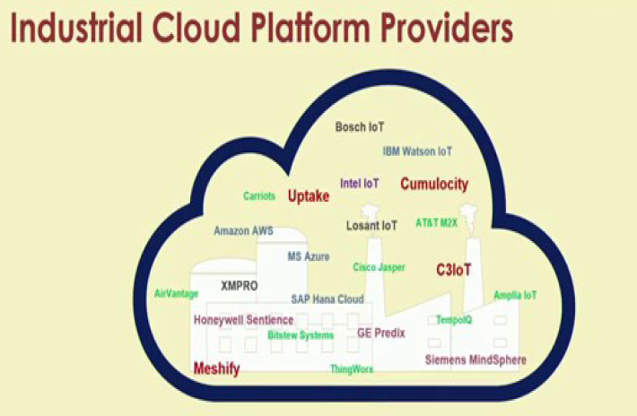

Slide 20
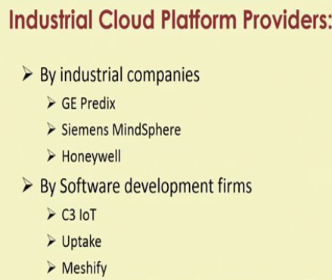

Slide 21
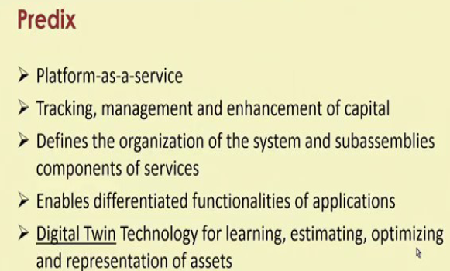

Slide 22
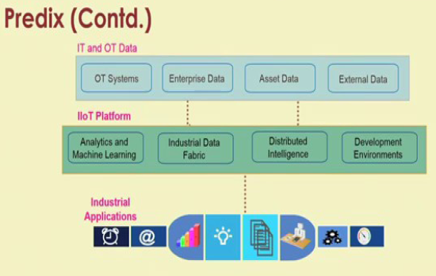

Slide 23
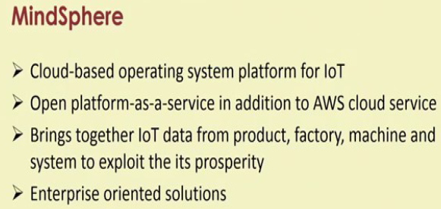
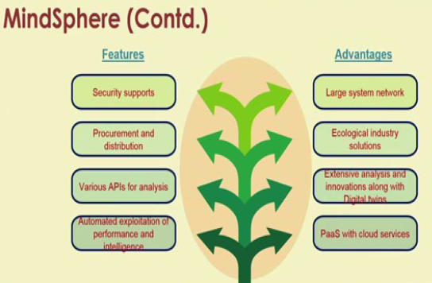

Slide 24
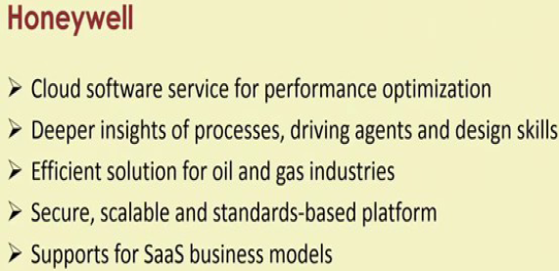
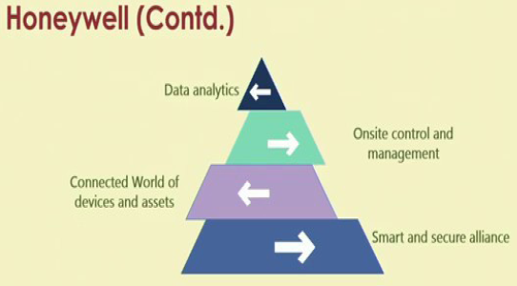

Slide 25
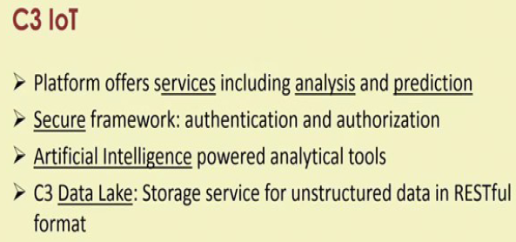
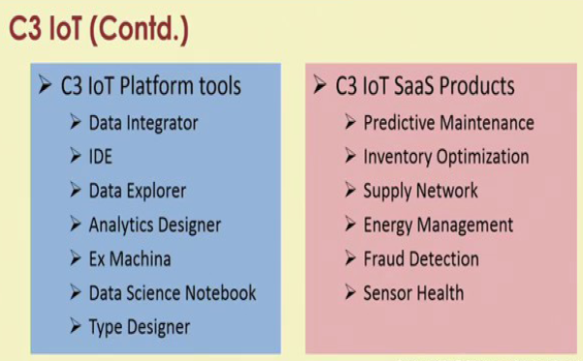

Slide 26
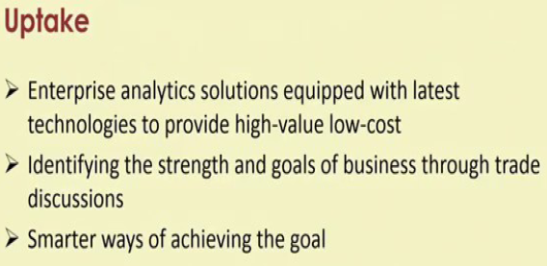
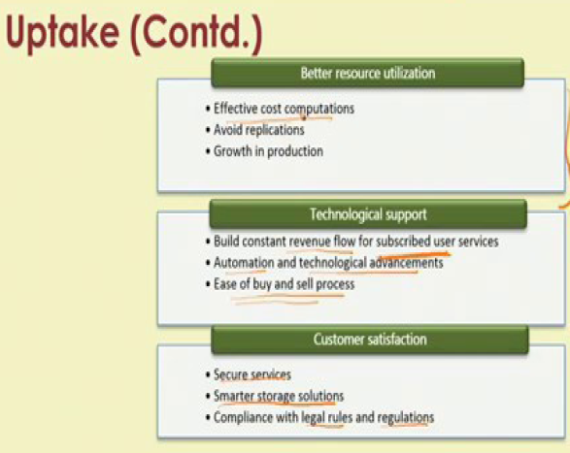

Slide 27
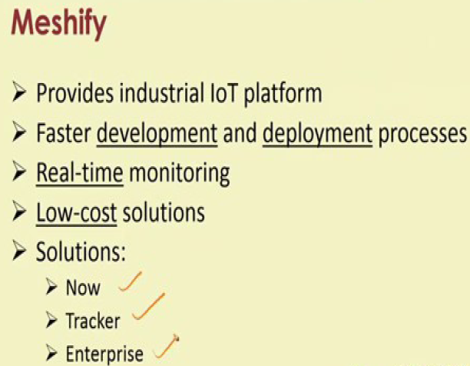
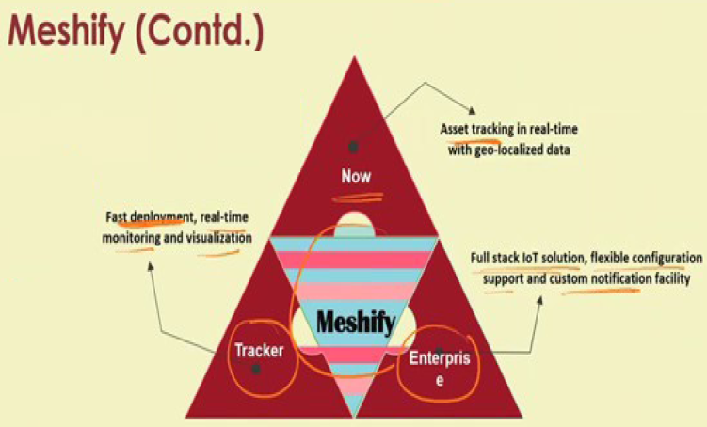

Slide 28
Service Level Agreement (SLA) for IIoT
Many IoT applications are real-time and include safety measures
Framework should achieve the goals as per plan
Services should be as per the agreement with cloud provider
A SLA helps the cloud provider in promising the deliverables
SLA helps the industrial client to check what and how good the
cloud provider gives service

Slide 29
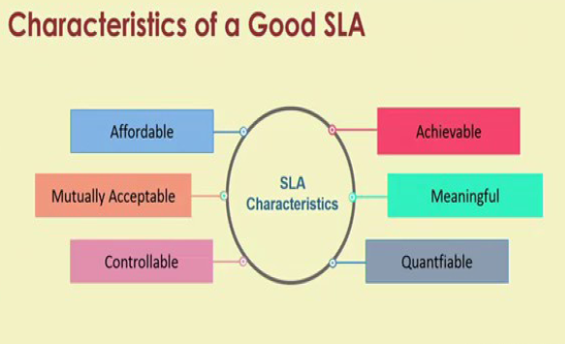

Slide 30
Current Status and Future of SLAs in IIoT
SLA-complied cloud service in IIoT is at infant stage for following
reasons:
Quality of services offered has interdependencies
Methodologies and frameworks of IIoT are not well developed
Life cycle management of an SLA in industrial context is not clear
Lack of SLA enforcement policies for both provider and
consumer
SLA support for IIoT is crucial along with business models
Future IIoT needs a standardization of SLA and its management

Slide 31
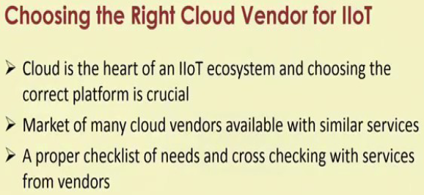
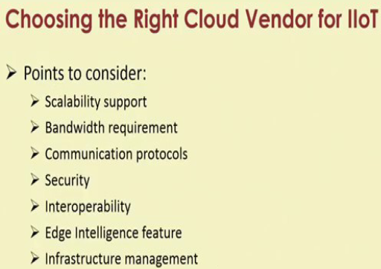

Slide 32
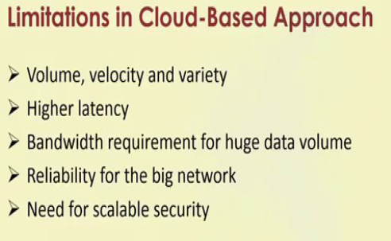

Slide 33
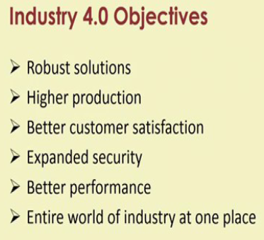
Requirements of Industry 4.0:

Slide 34
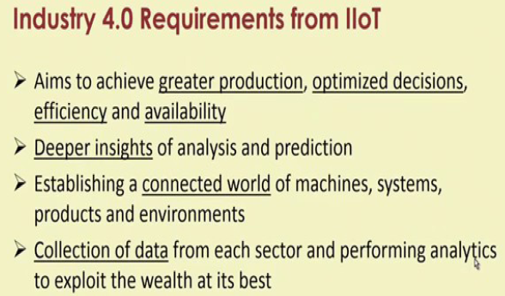
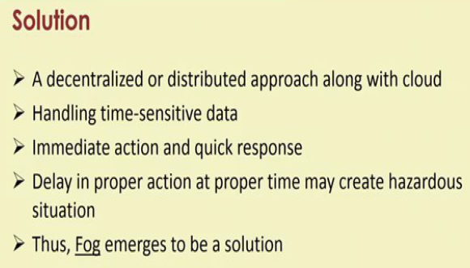

Slide 35
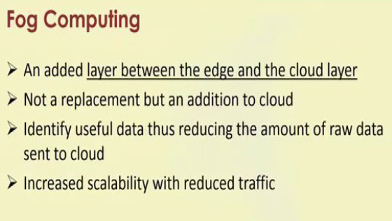
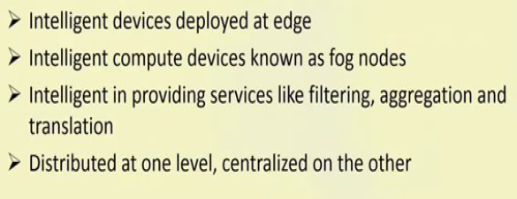

Slide 36
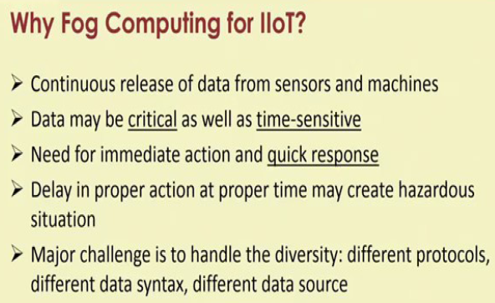
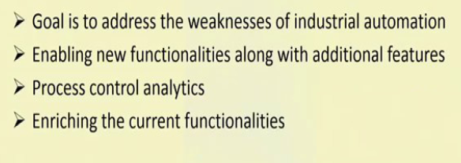

Slide 37
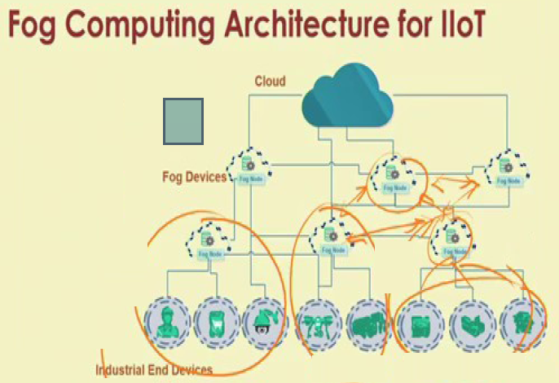

Slide 38
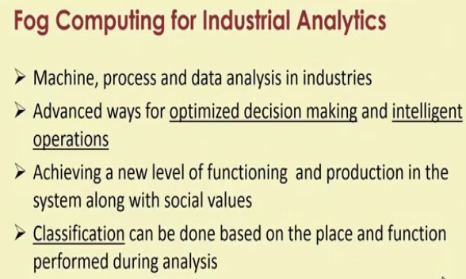
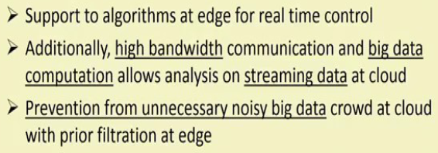

Slide 39
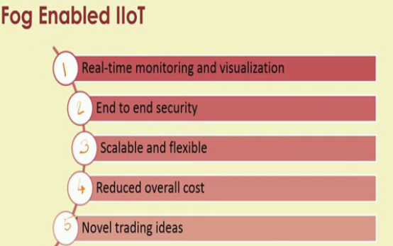

Slide 40
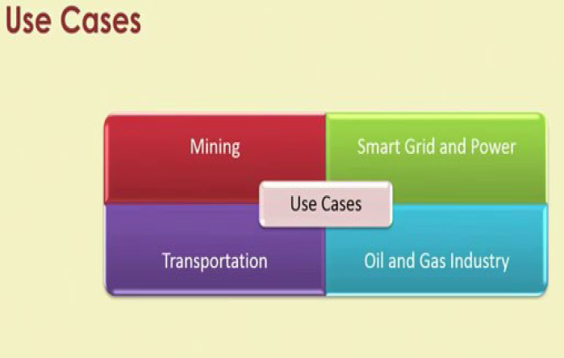

Slide 41
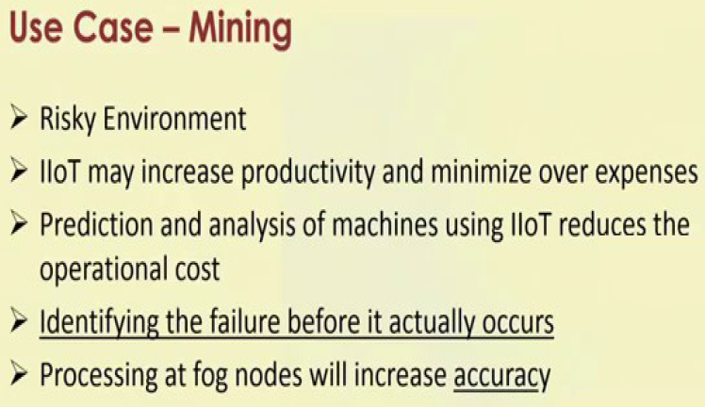

Slide 42
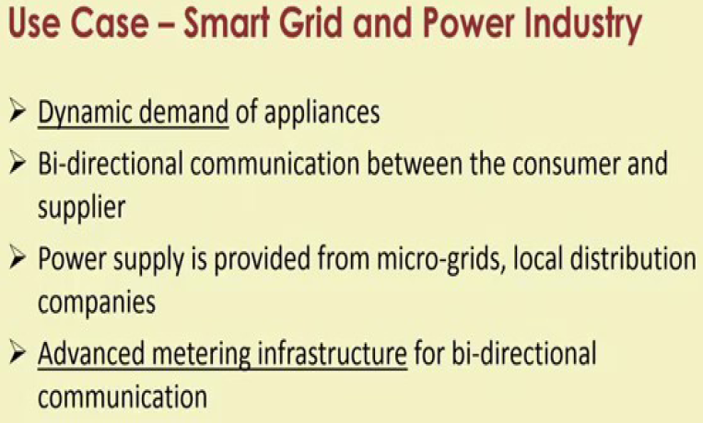

Slide 43
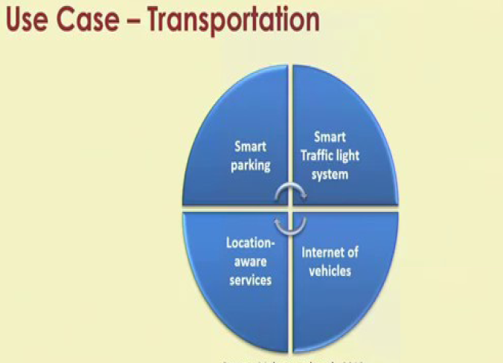

Slide 44
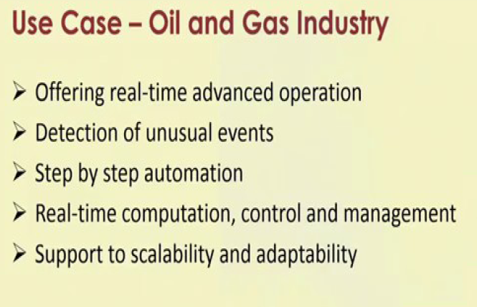

Slide 45
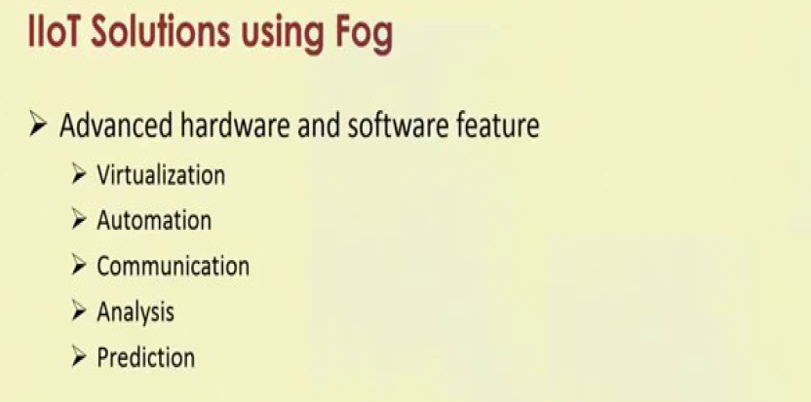
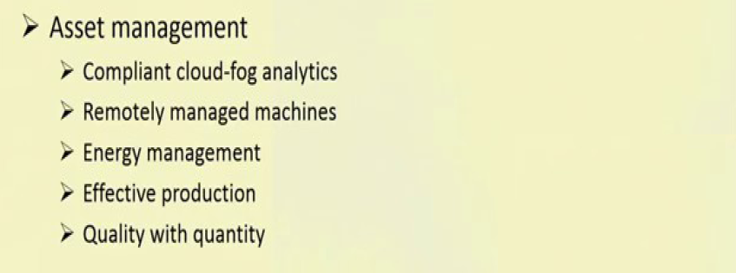
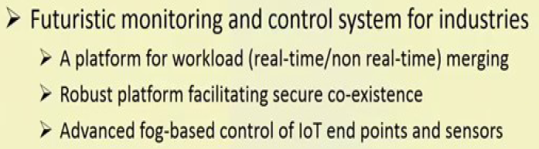

Slide 46
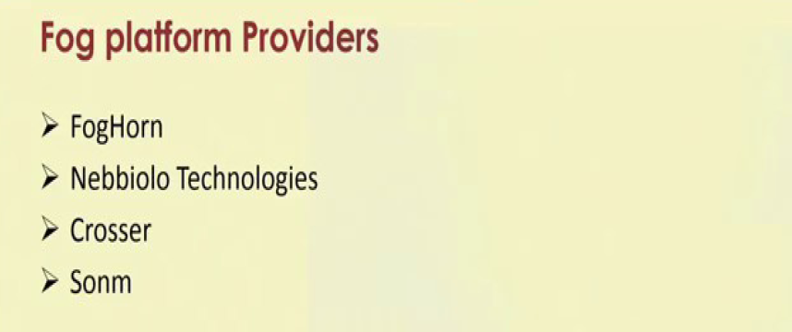
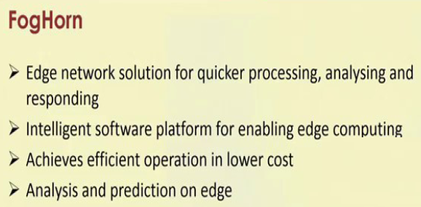

Slide 47
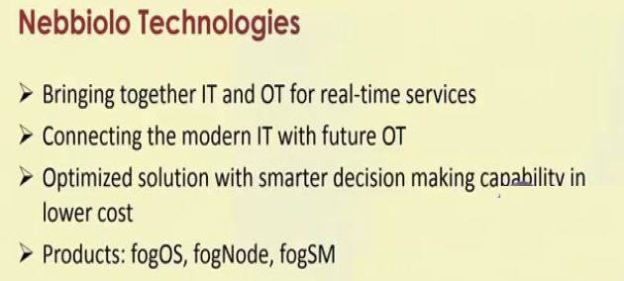
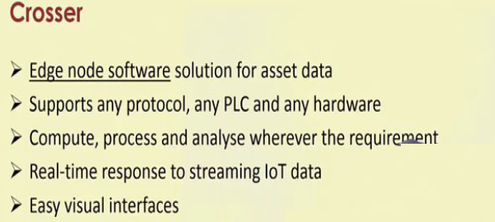
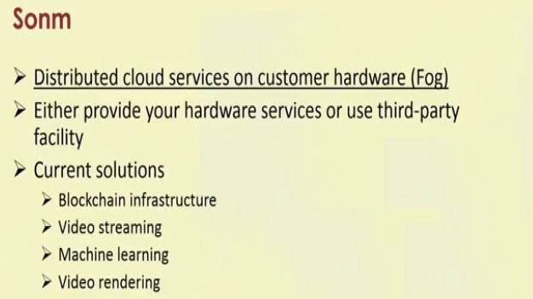

Slide 48
On-Site Technologies in IIoT:
Introduction:
On-Site technologies in IIoT play a crucial role in transforming traditional industries by enhancing connectivity, automation, and data exchange.
These technologies are deployed within the physical confines of industrial facilities to improve efficiency, productivity, and decision-making processes.
There are two key on-site technologies in IIOT, those are
1. Augmented Reality
2. Virtual Reality

Slide 49
Augmented Reality:
A combination of a real scene viewed by a user and a virtual scene generated by a computer that augments the scene with additional information.
An AR system adds virtual computer-generated objects, audio and other sense enhancements to a real-world environment in real time.
Goal of AR
To enhance a persons performance and perception of the world.
The ultimate goal is to create a system such that a user cannot tell the difference between the real world and the virtual augmentation of the world.

Slide 50
History of Augmented Reality:
The concept of overlaying computer-generated images onto the real world dates back to the late 1960s, when Ivan Sutherland created the first head-mounted display, called The Sword of Damocles.
In 1990, Boeing researcher Tom Caudell coined the term "augmented reality" to define the integration of computer-generated images into the real world.
In the late 1990s, NASA's X-38 spacecraft became the maiden utilization of AR for navigation
The year 2000 witnessed the launch of the pioneering AR game, AR Quake.
In 2012, Blippar released the first cloud-based AR app.
The number of AR users in the United States had hit 37 million by 2017 and was projected to reach 67 million by 2020.
The growth of the market has been attributed to the increased usage of AR devices across numerous industries, including #healthcare, #manufacturing, #supplychain, tourism, energy, and many more.

Slide 51
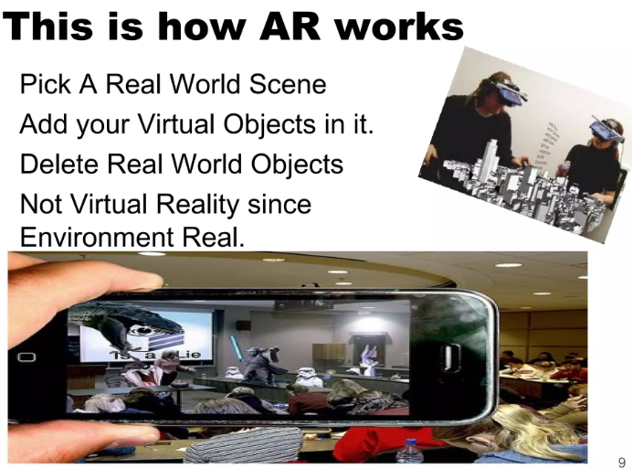

Slide 52
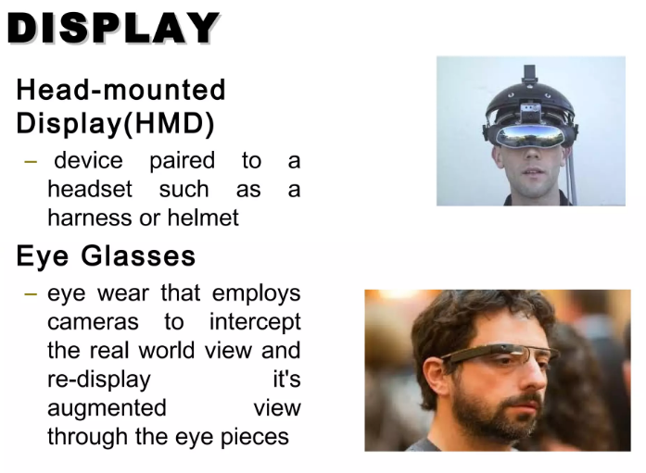

Slide 53
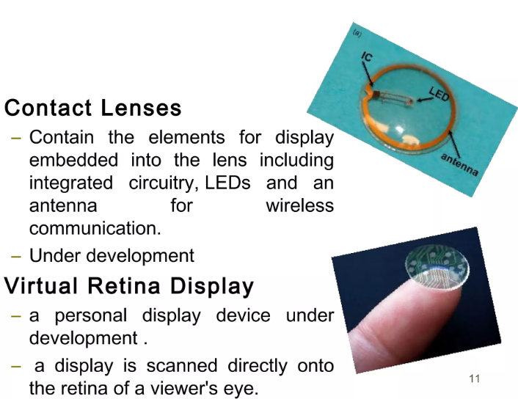

Slide 54
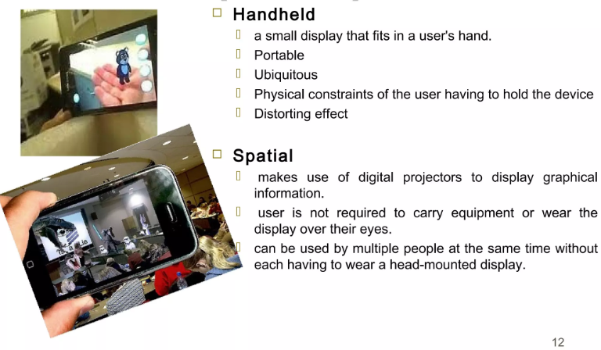

Slide 55
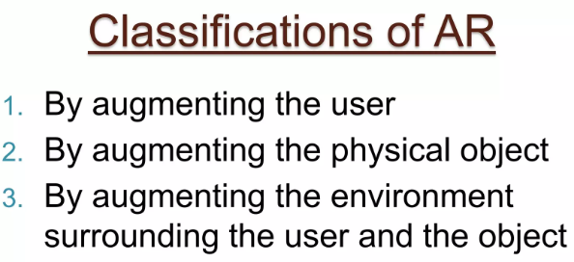

Slide 56


Slide 57


Slide 58


Slide 59


Slide 60


Slide 61


Slide 62


Slide 63


Slide 64

Virtual Reality:
Virtual Reality (VR) is a computer-generated environment with scenes and objects that appear to be real, making the user feel they are immersed in their surroundings. This environment is perceived through a device known as a Virtual Reality headset or helmet. VR allows us to immerse ourselves in video games as if we were one of the characters, learn how to perform heart surgery or improve the quality of sports training to maximize performance.

Slide 65


Slide 66


Slide 67


Slide 68


Slide 69


Slide 70


Slide 71


Slide 72



Slide 73


Slide 74



Slide 75


Slide 76


Slide 77


Slide 78


Slide 79


Slide 80


Slide 81


Slide 82


Slide 83


